Slide 1
DATA SPHERE
ACCELERATED DATA SCIENCE BOOTCAMP
PART - 2
Data Migration

Slide 2
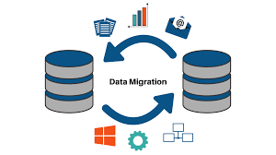
Definition
Data migration refers to the process of transferring data from one storage system to another, or from one format to another, while ensuring data integrity and consistency.

Slide 3
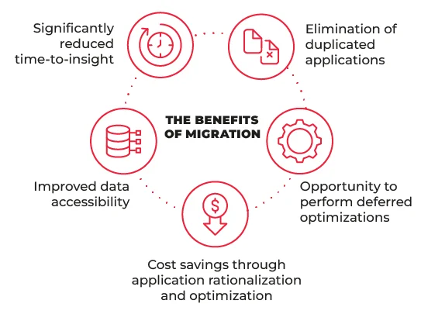
Importance and Benefit
Business Continuity: Data migration facilitates seamless operations during system upgrades or migrations, ensuring minimal disruption to business processes and continuity of services.
Compliance and Governance: Proper data migration processes help organizations adhere to regulatory requirements by ensuring data privacy, security, and integrity are maintained throughout the transition.

Slide 4

SQLAlchemy
SQL Toolkit and ORM
High-level Interface
Connecting to Databases
Executing SQL Queries
Managing Database Transactions

Slide 5

ALEMBIC
Lightweight Database Migration Tool
Define and Manage Database Schema Changes
Automation of Migration Scripts
Integration with SQLAlchemy

Slide 6
THANK YOU

